Slide 1
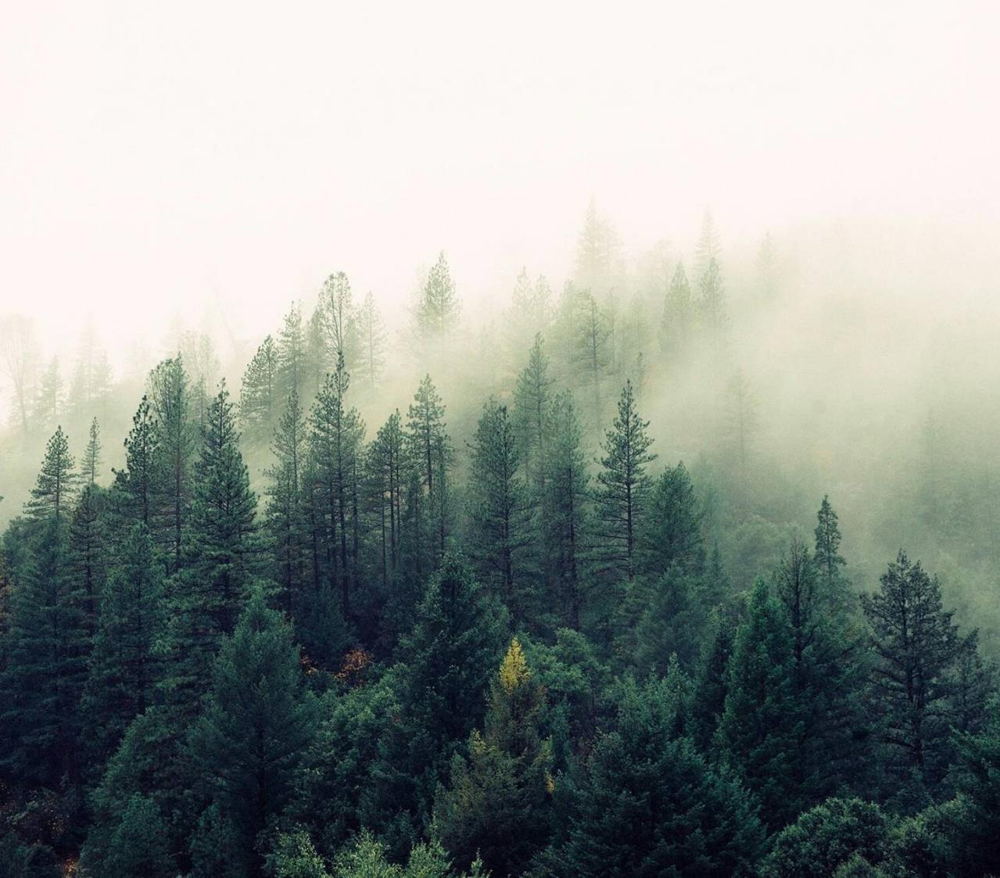
WildeFire Project
Data ScienceTech Institute
Python ML Labs
Quentin VoituroN
Luigi Giannetti
Sascha MOCCOZET

Slide 2
Table of content
Aim of the WildFire Project
Dataset
DataCube
Next Step

Slide 3
Aim of the WildFire Project
Create a Python Artificial Intelligence to output a better result as the FWI (Fire Weather Index) in term of accuracy, prediction and resolution, for cheaper.
The output will be a risk map for a given time (1day) and location (1km²) of wildfire prediction (low risk, medium risk, high risk, …) targeted on the PACA France region.
We will be able to evaluate our model on 2 results:
Against the FWI results (using the FWI results)
Against the real world (using our database on past data)
Notes:
FWI is expensive and only available in some rich country.
Risk to define.

Slide 4
Aim of the WildFire Project
Must Have
Nice to have
Daily risk map
Prediction map for the next day
Create a container to run the script
Notes:
Possibility to tweak the future data in order to see the impact of a given action (density, vegetation …)

Slide 5
Datasets
Leaf Area Index (from MOD15A2H v061)
NDVI (from MOD13A2 v061)
Evapotranspiration (from MOD16A2 v061)
Meteorological data (from ERA5-Land variables)
Land Surface Temperature (from MOD11A1 variables)
Fire Weather Index
Active fire variable
Burned mask variables ( from MYD14A2)
Density
Notes:
Start from academical article to benchmark input
TODO LINK TO ARTICLE
LAI => vegetation cover
NDVI / EVI => % vegetation and type of vegetation
Evapotranspiration => masse of water/humidity that get out of the earth (vegetation and ground)
Meteorological data => rain, temperature, wind
LST =>
FWI => meteorogical data
Active fire => day of first and last fire
Burned mask => where and when are wildfire (not same origin as Active Fire)
Density => Number of people by pixel

Slide 6
Datacube - properties
Time Range : 2010-01-02 to 2022-02-01
Time Resolution: 1 day
Spatial resolution: 1 km
Projection: sinusoidal
Spatial extent: AOI.
Notes:
Why sinusoidal? Because of the area of the fire in ²

Slide 7
DataCube - Variables
Fpar_500m - continuous
FparStdDev_500m - continuous
_1_km_16_days_EVI - continuous
ET_500m - continuous
U10 - continuous
V10 - continuous
T2m - continuous
tp - continuous
LST_Day_1km - continuous
LST_Night_1km - continuous
FWI - continuous
First_Day - categorical
Last_Day - categorical
Burn_Date_Uncertainty - categorical
FireMask - categorical
Density - continuous

Slide 8
Next Step
Pre-Processing
Clean the data
Split the data (Learning / testing)
ML – Model
Define the model to use
Test the model
DevOps
Data versioning
Notes:
Data
Get data on future event
Streaming
DevOps
Docker
Prefect + Airflow
Pre-Processing
Active fire and Burned mask need to be compared and pre-process
ML – Model
Random forest

Slide 9
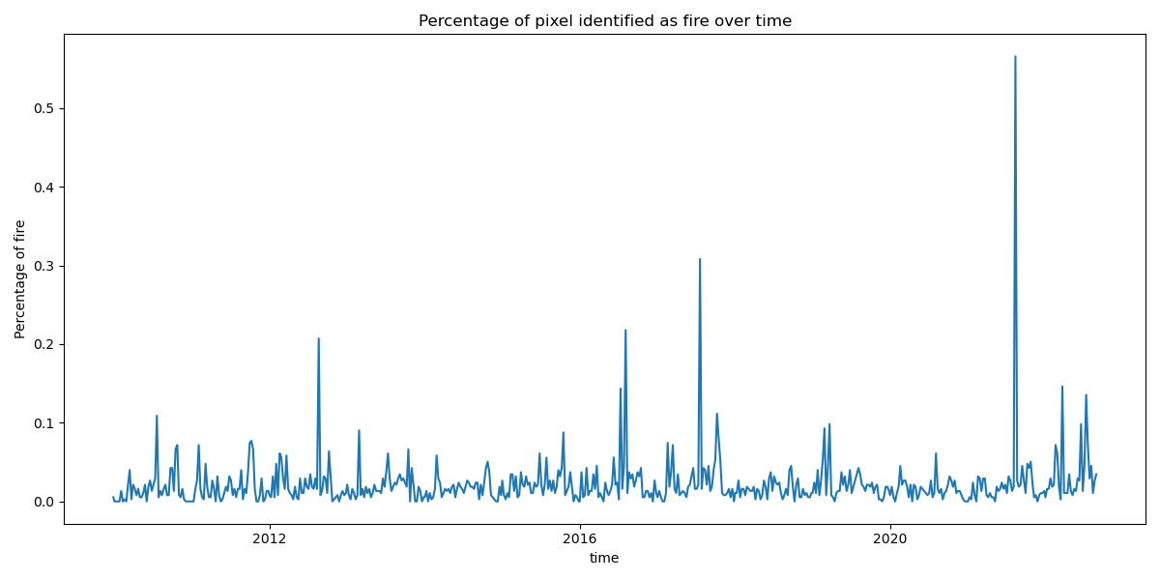
Difficulty
Dependencies
Projection
Merging of data
Learn: Raster, shapefile, spatiotemporal data,...
Unbalanced Dataset

Slide 10
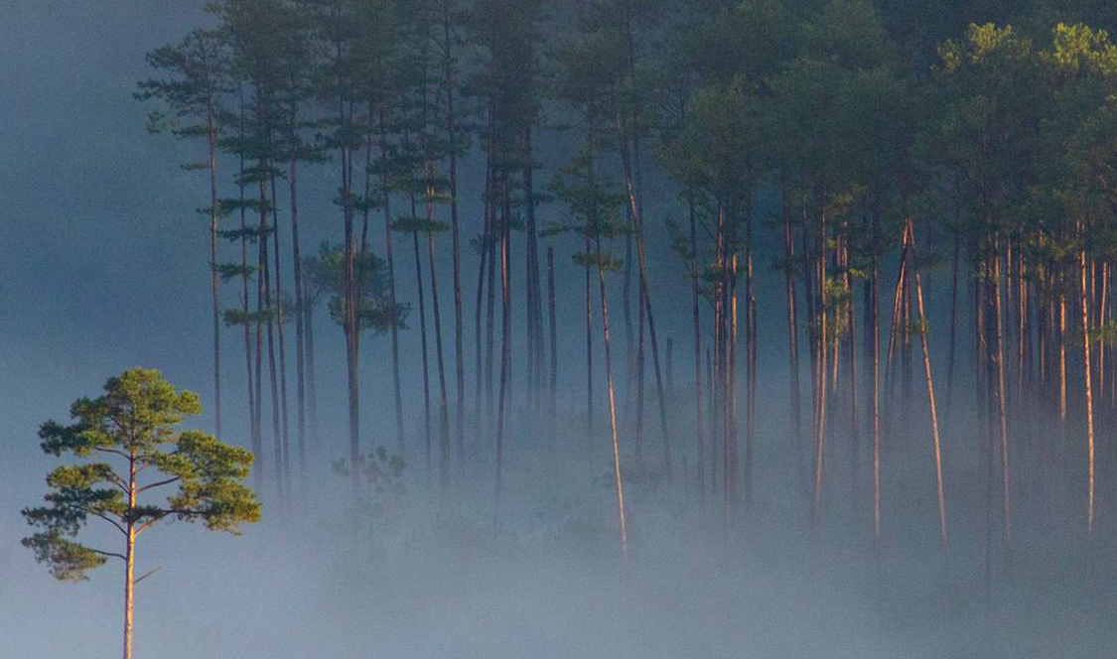
Thank you

